Slide 1
Sketchbook Name Illustration
Due at the beginning of class
Friday 9/15

Slide 2
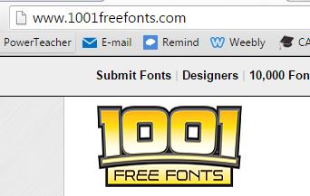
Make sure you name is illustrated creatively
Notes:
This website is great for inspirational fonts. You can type you name in the preview window and click update to see each font in your name. Dafont.com is another good website for fonts.

Slide 3
Assignment
Illustrate your name in a creative way to represent yourself.
No stick letters. Visit 1001freefonts.com for inspirational fonts.
Creatively draw each letter balanced across the page from top to bottom and side to side. It does not have to be read from left to right like a traditional English paper.
Be creative perhaps you drastically change the size of the first letterMake sure your name is contrasting to the background.
Make sure your drawing has unity, it follows a theme that represents your personality.
You must fill over half of the background
Color it neatly, I recommend avoiding marker unless it's meant to emphasis something.

Slide 4
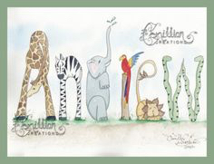
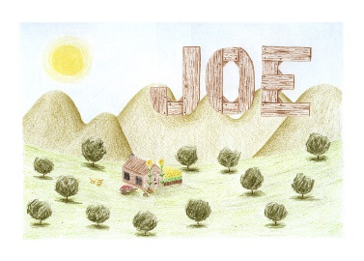
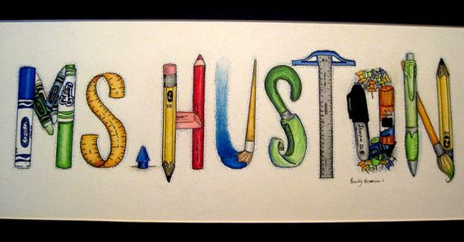
Draw 4 Rough Drafts
Turn to page 6 in your sketchbook.
Divide the page into 4 even rectangles by drawing a horizontal and vertical line across the middle of the paper.
In each section illustrate and color 4 very different ideas (rough drafts) for your name illustration.
Change the font and change the background in each rough draft so you have variety.
Ask your teacher when the 4 rough drafts are due.

Slide 5
Here are some inspirational ideas
Which include examples of:
Space
Contrast
Balance
Unity

Slide 6
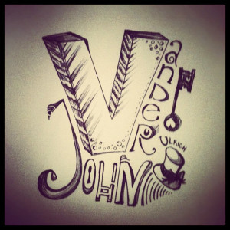
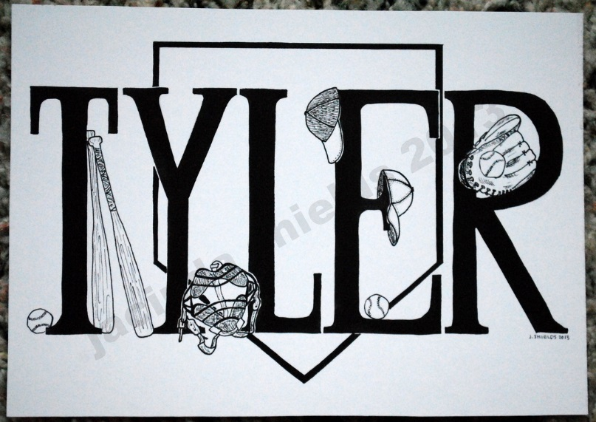
Use the space to balance your name on your page in a creative way. It must fill over half the page.
Notes:
In the Berlin example the artist uses the negative space to illustrate the text. In Tyler’s name the images interact with the letters. In John Vander’s name drawing the name frames the letter V.

Slide 7
Make sure you can read it from across the room.
Good example Bad Examples
Notes:
The first example is more successful for this assignment because I can read it from across the room. It has strong contrast because the letters have a white halo around the text. This is always a good trick to use if your background has a lot going on. The two examples on the right are creative but hard to read.

Slide 8
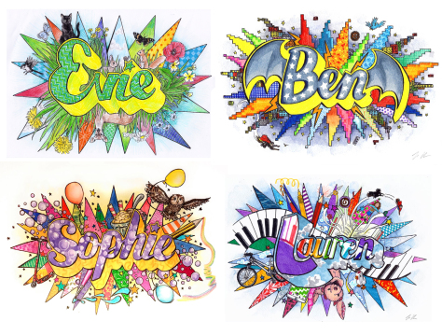
Fill the whole background and keep it balanced. The name and the background must have Unity.
Notes:
Notice all of them have a very busy background, so the artist added an outline around the name.

Slide 9
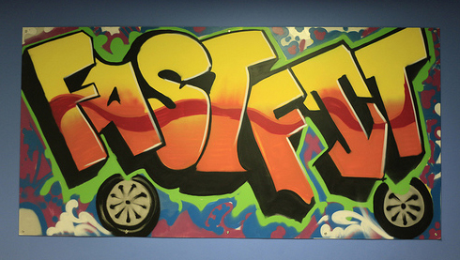
Fill the whole background and keep it balanced. The name and the background must have Unity.

Slide 10
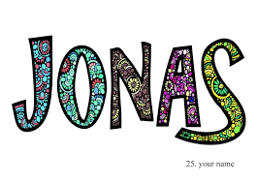
Make sure your name has contrast. I must be able to read it from 15 feet away.
Notes:
The only thing this one is missing is a background. You could do a gradient of colors fading from light to dark from the outside in or from top to bottom. Or you could add a landscape scene.

Slide 11
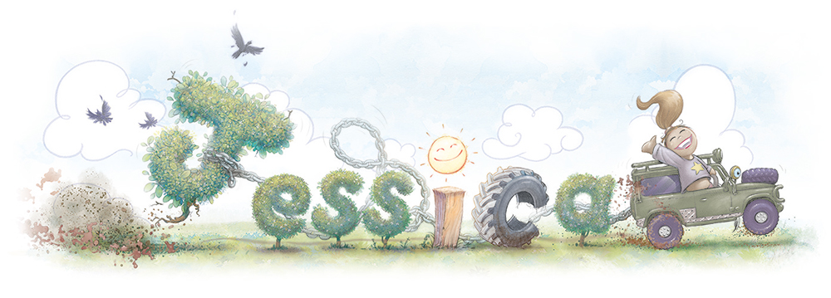
Fill the whole page by adding a background. You must balance the background. The name must have contrast and unity.
Notes:
This one has strong Unity. Describe the (unity) theme in Jessica’s drawing.

Slide 12
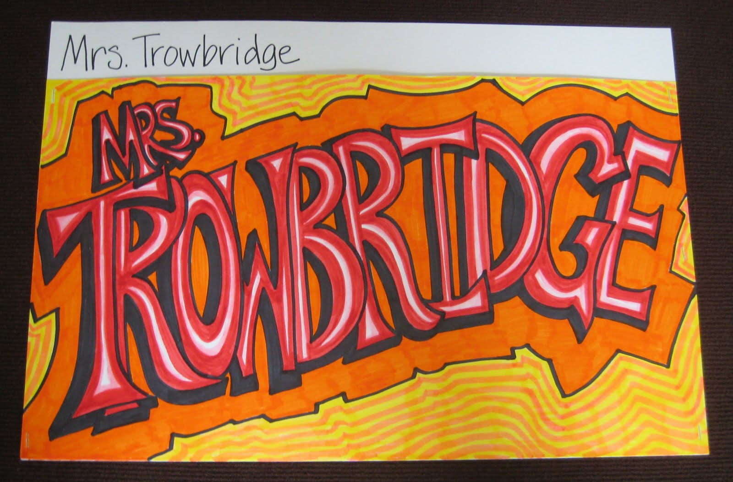
Include balance contrast and unity.

Slide 13
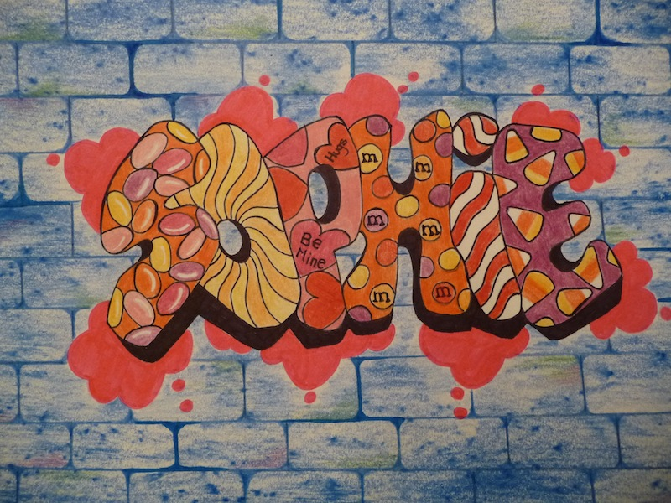
Include balance contrast and unity.

Slide 14
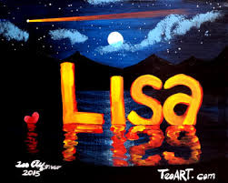
Include balance contrast and unity.

Slide 15
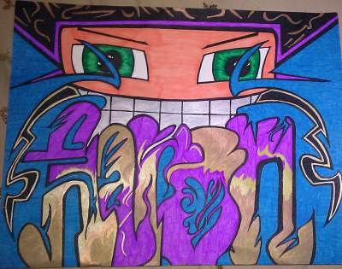
Include balance contrast and unity.

Slide 16
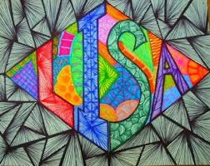
Include balance contrast and unity.

Slide 17
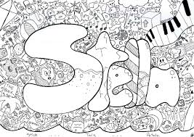
Include balance contrast and unity.

Slide 18
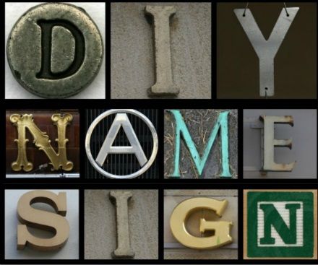
Include balance contrast and unity.

Slide 19
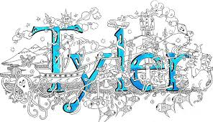
Include balance contrast and unity.

Slide 20
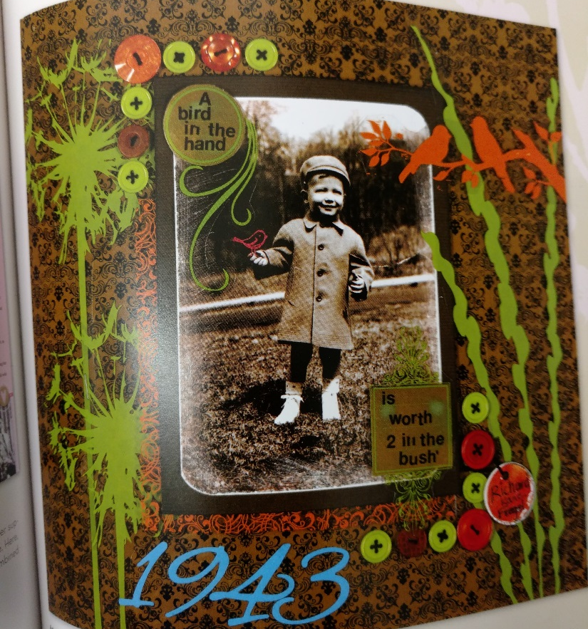
Include balance contrast and unity.
Collage ideas

Slide 21
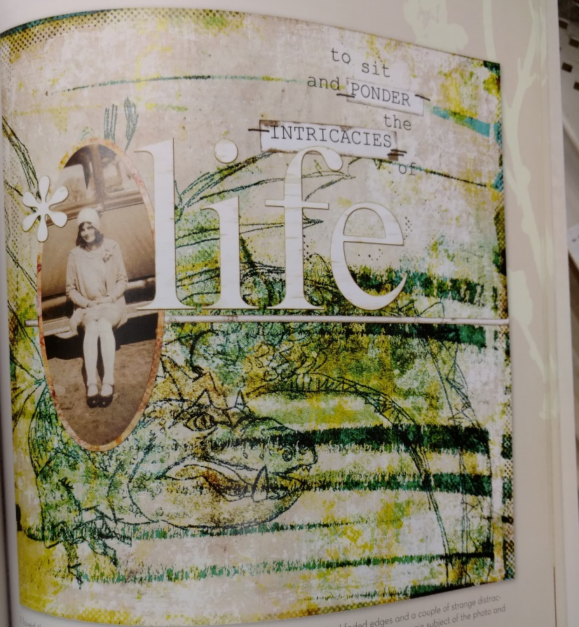
Include balance contrast and unity.
Collage ideas

Slide 22
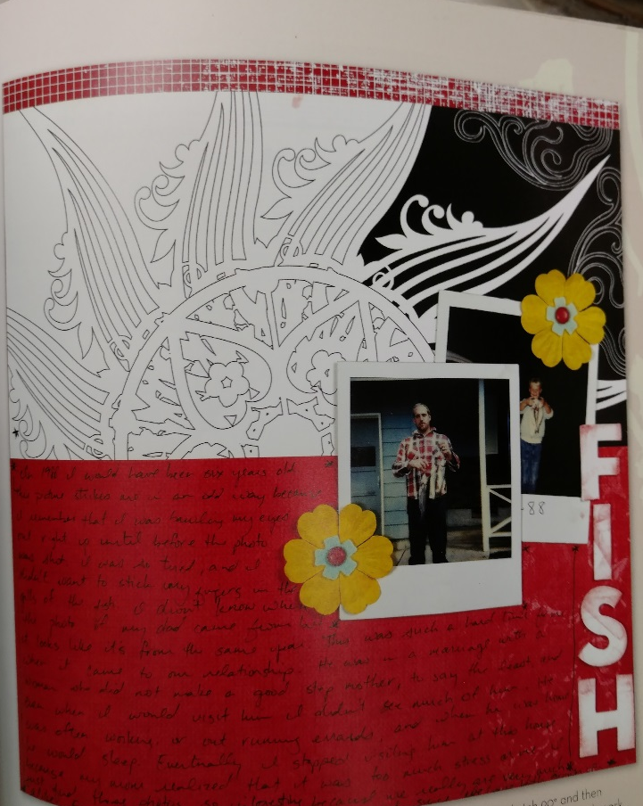
Include balance contrast and unity.
Collage ideas

Slide 23
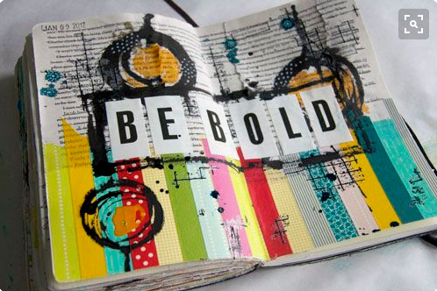
Include balance contrast and unity.
Collage ideas

Slide 24
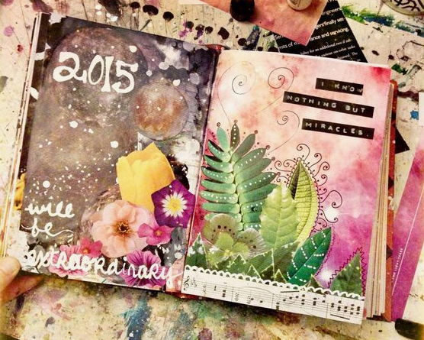
Include balance contrast and unity.
Collage ideas

Slide 25
Include balance contrast and unity.
Collage ideas

Slide 26
Requirements
Name Illustration – It is creative (no stick letters) and original (not copied)
Balance –The design is balanced from top to bottom and from right to left.
Contrast – I can read it from 15 feet away.
Unity – The design displays a clear theme.
Background – It represents your personality and it fills over half of the page.
Neatness – No smudges, tears, folds, wrinkles, or stains. Lines are clear. No pencil lines showing.
Completion – The design fills the whole page and it is finished.

Slide 27
Category | 4 Excels Expectations | 3 Strong Understanding | 2 Basic Understanding | 1 Not there yet
Letters Space and Balance | Your name illustration is an original design. Your letters are spaced effectively, the design is balanced. | Your name illustration is copied from an inspirational image. The letters are not spaced efficiently in 1-2 areas. | Your name illustration is copied from an inspirational image. The letters are not spaced efficiently in 3-4 areas. | Your name illustration is copied from an inspirational image. The letters are not spaced efficiently in 5-6 areas.
Contrast | Your name has so much contrast that it stands out from across the room 15 feet away. The name is very easy to read. | Your name has some contrast, but can only be read from 10 feet across the room. It is easy to read. | Your name is lacking contrast, it can only be read 5 feet from across the room. It is somewhat legible. | Your name has no contrast, it blends in with the background or you can not read it.
Background & Unity | Over half of the background is filled. The design clearly represents your personality. The theme is clear and strong. | Half of the background is filled. The design does not clearly represent your personality or the theme is not as clear. | 1/3 of the background is filled. Either the design does not clearly represent your personality or the theme is unclear. | Less than 1/3 of the background is filled. The design does not clearly represent your personality and the theme is unclear.
Neatness | There are no smudges, tears, folds, wrinkles, or stains on the paper. The lines are clear and crisp. Every erased mark is erased. The coloring is neat and not scribbled. | There are 1-2 mistakes or messy areas. | There are 3-4 mistakes or messy areas. | There are over 5 mistakes or messy areas.
Accountability | Your name illustration was turned in on time. | 1 class late | 2 classes late | 3 classes late

